Slide 1


AmazeCare (Hospital Management System)
By,
Sushmitha S

Slide 2

PROBLEM STATEMENT
Traditional systems involve long wait times and manual booking, causing delays in patient care.
Patient records are often scattered or paper-based, making it difficult for doctors to access complete medical history.
There is no dedicated platform for real-time and secure communication between patients and healthcare providers.
Managing appointments, doctor schedules, and patient data manually is time-consuming and error-prone.
Existing solutions lack integration, modern UI, and secure authentication mechanisms like JWT, compromising both usability and data safety.

Slide 3

OBJECTIVE
To provide an intuitive interface for patients to book, view, and manage doctor appointments online.
To Maintain centralized, accessible, and secure electronic medical records for efficient diagnosis and treatment.
To Implement JWT-based authentication and authorization to ensure data privacy and user-specific access (Admin, Doctor, Patient).
To allow administrators to manage doctors, patients, and appointments efficiently through a dedicated dashboard.
To facilitate seamless communication and consultation tracking with prescription generation and test recommendations.

Slide 4


TECHNOLOGY STACK
Category | Technology Used
Language | Java 17
Framework | Spring Boot 3.2.5
Security | Spring Security + JWT
ORM | Spring Data JPA
Database | MySQL
Docs / Testing | Swagger (OpenAPI), JUnit 5

Slide 5
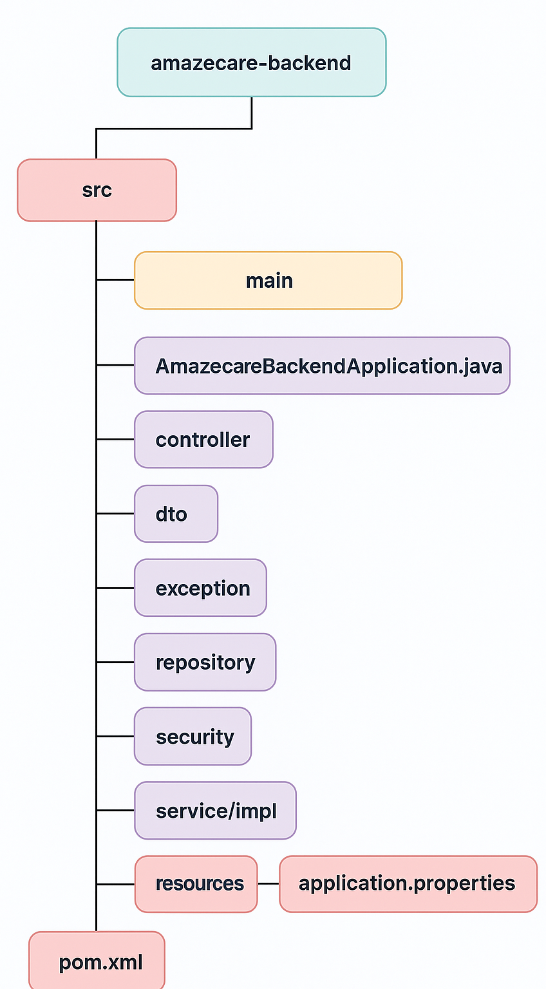
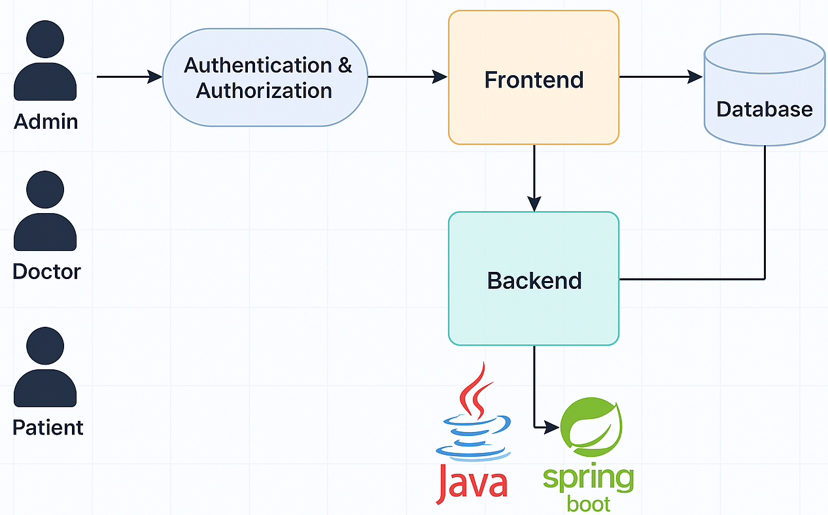
SYSTEM ARCHITECTURE

Slide 6
ENDPOINTS
Role | HTTP Method | Endpoint | Description
Public | POST | /api/auth/register | Register a new user (Admin, Doctor, or Patient)
Public | POST | /api/auth/login | Authenticate user and return JWT
Admin | POST | /api/admin/add-doctor | Add a new doctor
Admin | POST | /api/admin/add-patient | Add a new patient
Admin | DELETE | /api/admin/delete-doctor/{id} | Delete doctor by ID
Admin | DELETE | /api/admin/delete-patient/{id} | Delete patient by ID
Doctor | GET | /api/doctor/appointments/{ doctorId} | View all appointments for the doctor
Doctor | POST | /api/doctor/prescribe | Add prescription and mark appointment as completed
Doctor | PUT | /api/doctor/cancel/ {appointmentId} | Cancel an appointment
Patient | POST | /api/patient/book | Book a new appointment
Patient | GET | /api/patient/appointments/{ patientId} | View upcoming appointments
Patient | GET | /api/patient/history/ {patientId} | View past medical consultation history (completed visits)

Slide 7
FLOW OF JWT AUTHENTICATION
User Login:
User sends their username and password to `/api/auth/login`.
Authentication:
Backend verifies credentials using Spring Security and loads user details from the d
database.
Token Generation:
Valid, a JWT token is generated with the user’s username, role, and expiry.
Token Response:
The JWT is sent back to the client (Angular), which stores it (e.g., in localStorage).
Protected Request:
For every secure API request, the client includes the token in the `Authorization`
header.
Token Validation:
‘JwtRequestFilter` intercepts the request, validates the token, and sets the user
context.
Access Control:
Spring Security allows or denies access based on the user’s role defined in the token.

Slide 8
ERROR HANDLING
Centralized Global Exception Handling:
Has ‘@RestControllerAdvice’ class (`GlobalExceptionHandler.java`) to handle all exceptions in one place, improving code maintainability.
Custom Exceptions:
Validation Error Handling:
If a request body fails validation (e.g., missing required fields or wrong formats), `MethodArgumentNotValidException` is triggered.
Generic Exception Handling:
Any unhandled or unexpected exception is caught by a generic `@ExceptionHandler(Exception.class)` method.
Exception Class | Description
BadRequestException | Thrown when invalid input is provided (e.g., missing required fields).
ResourceNotFoundException | Thrown when requested resource is not found (e.g., doctor/patient ID not found).
UnauthorizedException | Thrown when access is denied (e.g., invalid login or access to a restricted route).

Slide 9
SWAGGER INTEGRATION
Swagger (now OpenAPI) is a tool for documenting and testing REST APIs.
It provides an interactive UI to:
View all available endpoints
Test APIs with sample inputs and JWT tokens
Automatically generate OpenAPI JSON docs
<dependency>
<groupId>org.springdoc</groupId>
<artifactId>springdoc-openapi-starter-webmvc-ui</artifactId>
<version>2.2.0</version>
</dependency>

Slide 10
DATABASE DESIGN
Table | Primary Key | Related Entities
users | id | doctor, patient (via one-to-one)
doctors | id | user (one-to-one), appointment (many)
patients | id | user (one-to-one), appointment (many)
appointments | id | doctor (many-to-one), patient (many-to-one)
prescriptions | id | appointment (one-to-one)
medical_records | id | appointment (one-to-one)
test_recommendations | id | appointment (one-to-one)

Slide 11

FUTURE ENHANCEMENT
Email/SMS Notifications:
Notify patients about appointment confirmations, cancellations, and reminders.
Online Video Consultation:
Integrate secure video calling for remote doctor-patient consultations.
Payment Gateway Integration:
Enable patients to pay consultation or booking fees online using UPI, cards, etc.
Lab Report Upload & Viewing:
Allow patients and doctors to upload and access diagnostic reports.
Admin Analytics Dashboard:
Visualize system usage, appointment trends, and doctor workloads through charts.

Slide 12

CONCLUSION
AmazeCare digitalizes healthcare operations by streamlining appointments, medical records, and consultations.
It ensures secure and role-based access using JWT authentication for Admin, Doctor, and Patient roles.
The system offers a clean API structure with integrated Swagger documentation for easy testing and development.
Doctor–patient interactions are made efficient with features like prescription management and appointment history.
The architecture is scalable and ready for enhancements like video consultations, billing integration, and analytics.

